Slide 1
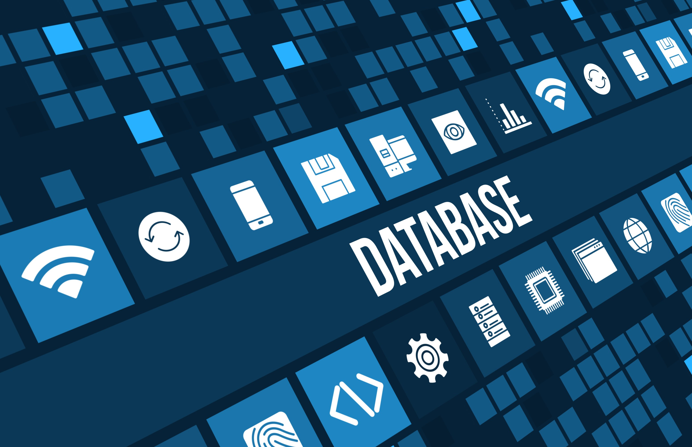

Slide 2
What is database?
Database is a systematic collection of data.
Databases support storage and manipulation of data.
Databases make data management easy.
Applications: business, sales, universities etc.,

Slide 3
Need of database?
databases organize data items and maintain relationships between them in order to facilitate effective information sharing across an organization, the WWW, etc.
To manage large chunks of data
Accuracy
Ease of updating data
Data integrity
Security of data

Slide 4
Data modelling
Data model is an abstract model that defines how data is stored and related to another.
File system
A database file system is a file system interface placed on top of files and directories that are stored in database tables.

Slide 5
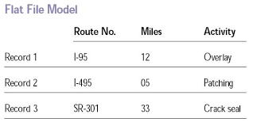
Flat file model:
A flat file model is a database stored as an ordinary unstructured file called “flat file”
Flat file databases are generally in plain-text form, where each line holds only one record

Slide 6
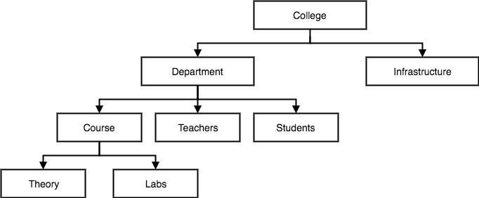
Hierarchical database
It is a data model in which the data is organized into a tree like structure.
The entity type records defines which fields the record item contain

Slide 7
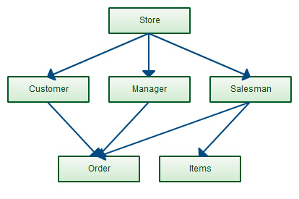
Network data model
An enhanced form of hierarchical model is data model, the network model represents data in a tree of records.
Relationship between tables(records) are expressed as sets.
Related records in a set are directly linked by pointers, rather than maching duplicates as in case of Relational Data Model.

Slide 8
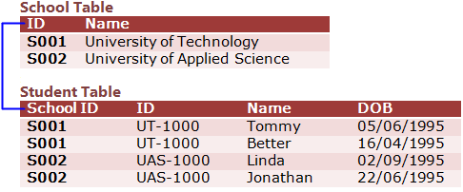
Relational data model
Data is organised in two dimensional tables called “Relations”.
A relational data model involves the use of data tables that collect groups of elements into relations.
Consists of three Major components:
set of relations
Integrity rules
Operations performed

Slide 9
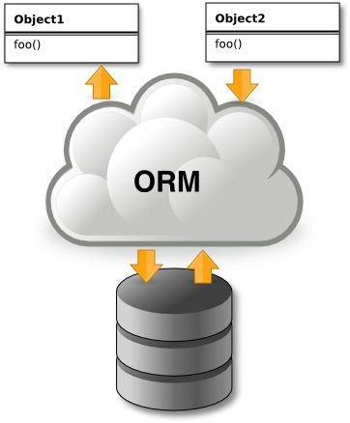
Object relational model
An ORDBMS has a relational model in it, because the data is stored in the form of tables having rows and columns.
SQL is used as the query language,
and the result of the query is also table or
tuple(rows).

Slide 10
File based approach
File based Approach is a traditional approach of collecting and storing data.
In this approach data is stored in files.
Each unit of organization has its own files and each file has a specific set of programs that were used to manipulate data in that file.
Each department collected and maintained the required data.
DISADVANTAGE:
This usually resulted in duplication of data and inconsistency of data.

Slide 11
DISADVANTAGE:
This usually resulted in duplication of data and inconsistency of data.
Seperation and isolation of data.
Fixed assistance of queries.
Incompatibity of files

Slide 12
DATA BASE APPROACH
The Database is a shared collection of logically related data, designed to meet the information needs of an organization.
A database is a computer based record keeping system whose over all purpose is to record and maintains information.
The database is a single, large repository of data, which can be used simultaneously by many departments and users.
Instead of disconnected files with redundant data, all data items are integrated with a minimum amount of duplication.

Slide 13
GUIDELINES(REFER ONLY)
data file is a collection of related records stored on storage medium such as hard disk or optical disk.while Database is a collection of data organized in a manner that allows access,retrieval and use of that data.

Slide 14
FEATURE
DESCRIPTION
OS
INTERFERENCE
LICENCE
LANGUAGES
My SQL | Oracle | Ingres | MS SQL
RDBMS | RDBMS | RDBMS | DBMS
Windows, linux solaris etc; | Windows, Linux, free BSD etc; | Windows, Linux etc., | Windows
GUI ,SQL | SQL | GUI,SQL | GUI,SQL,VARIOUS
OPEN SOURCE | COMMERCIAL | OPEN SOURCE | COMMERCIAL
Ada C C# C++ D Java Perl PHP Python RubyTcl etc., | C C# Perl PHP Python Visual Basic etc; | .Net C C++ Delphi Java Perl PHP Python Tcl | JAVA, RUBY, PHYTHON,.NET,VB and PHP

